Slide 1
Lecture 1:
Intro/Wireframes

Slide 2


Slide 3





Who am I?
Lead Front End Developer @ Postman
Previous employment
Software Engineer @ Airbnb (1.5 yrs)
Web Developer @ ASUS North America (1 yr)
Web Developer @ Incentive Networks (2.5yrs)
Portfolio: https://www.williamsfuller.com/
GitHub: https://github.com/wsfuller

Slide 4
Intro: Tell us about yourself
Helpers:
What is your name?
Where do you work?
What’s your major?
What do you hope to learn?
What kind of music are you into?
What are you excited about for this class?
etc.
Tell us a FUN FACT about yourself

Slide 5

Disclaimer: Grades and Homework submission
Starting this quarter or next we should all be using Canvas
I haven’t used Canvas up to this point and this will be the first time
I ask for patience and help from you to make this experience as positive as possible

Slide 6
Intro: What is this course about?
Flow of building a website
Wireframe a website
Design a website
Prototype a website
Code a website
Deploy your site
Use free GitHub Pages
Or buy a domain/hosting
Learn
How to ask questions
Where to find help
Networking/How the Internet works w/Guest Speaker
Bootstrap Framework and other helpful tools
Some limitations and challenges of browsers

Slide 7
Intro: What to expect in/out of class
In class
Introduction
Student Feedback
How can the class be improved?
Lecture
Break
Demonstration
Break
Class time (varies)
Outside of class
Practice coding HTML and CSS examples
Use any and all resources
w3schools.com
CSS Tricks
YouTube
etc.
Homework
Wireframes
1-2 hours
Design
2-3 hours
Coding
4+ hours

Slide 8


Intro: What we will learn
HTML 5
Content
Structure
CSS 3
Style
Presentation
JavaScript
Behavioral

Slide 9


Intro: Tools
+
Git
GitHub

Slide 10


Intro: Tools
Atom Text Editor
Used for coding
Flexible with plugins and themes
Made by the folks at GitHub
Available macOS/Windows
Free
GitHub Desktop
GUI for working with Git
Easier then using Terminal or Command Line
Made by the folks at GitHub
Available macOS/Windows
Free

Slide 11
Intro: Can I use other text editors?
But I want to use
Sublime Text
Notepad++
Brackets
Vim
Emacs
Komodo
Visual Studio
Webstorm
If you travel this road you will be doing it as a lone wolf. As I’ve used many of these editors before I’m not advising it for this course. It makes everything run better when you use the tools of the many not the few.

Slide 12

Intro: What Browser should I use?
I highly encourage you use Chrome in this class
Easier for me to help you
Solid Developer Tools
Used for in class demos
Grading Finals with
Note: There’s nothing wrong with other browsers. But like in the previous slide, “It makes everything run better when you use the tools of the many not the few.”

Slide 13
Intro: Do we need to read the book?
Si
Oui
YES!!!
Hai
Shi
Ja
Sim

Slide 14

Intro: The Book

Slide 15
Intro: Why the book is important
Lectures are loosely based on chapters in the book
Reading the book
Will give you a head start
Help form questions
Introduce you to new concepts
Although this version of the book is dated the concepts are still relevant

Slide 16



Intro: You will get to this point...a lot

Slide 17

Intro: Feeling meh, confused, frustrated, etc.
And sometimes you’re going to feel like this…
Raise your hand
Ask questions
Ask for help
Did you try Google?
Did you try Stack Overflow?
Maybe you need to take a break
Reach out to me
Email me: steve_fuller@berkeley.edu
Ask me to come to class early
Stay after class

Slide 18

Intro: Helpful resources
These sites will help you with everything covered in this class
...srsly
HTML w3schools
CSS w3schools
JavaScript w3schools
CSS Tricks
HTML 5 Cheatsheet
CSS Cheatsheet
Stack Overflow

Slide 19
Intro: Website Requirements
Here is my band website
Minimum Website Requirements:
Homepage
Full screen image
HTML 5 Video (Optional)
About page
X2 large paragraphs of text
X2 lists
Import at least 1 image within a paragrah
Tell me all about the band I want to understand who they are and what they are about
Discography
X3 albums
Album covers, album title, release date, numbered tracks
Media
X8 thumbnail images
Images must have Lightbox effect
X3 embedded YouTube Videos
Merch
X6 merch items
Must be able to Filter items
X2 categories
Tour Dates
HTML Table with headers: Venue, Location, Date, Time, and Where to buy tickets
X10 Dates must be present
Link out to Venues and/or Where to Buy tickets
Deploy Site
GitHub
Hosting and Domain (Bonus)

Slide 20
Intro: The end goal of this course
Identify
Wireframe
Design
Prototype
GitHub
Code
Deploy

Slide 21


Slide 22
Sign up for GitHub

Slide 23
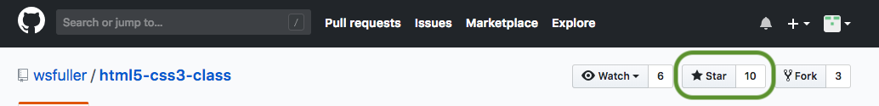
Intro: Sign up for GitHub
Go to GitHub
Sign up for GitHub
Create account
Choose your plan
Default Unlimited Public
Tailor your Experience (optional)
Go to class Repository
Click the Star, bookmarks
In this repository you will see several links
class-resources
class-directory
Lectures
Lectures will be uploaded in .pdf and .pptx formats from Google Slides
deftones-site.sketch
final-project, this is my final coded site

Slide 24

Intro: Class Resources
Within GitHub you will find class-resources
These resources will be:
Lectures
Uploaded by next evening
Code Examples from Class
Syllabus
etc

Slide 25
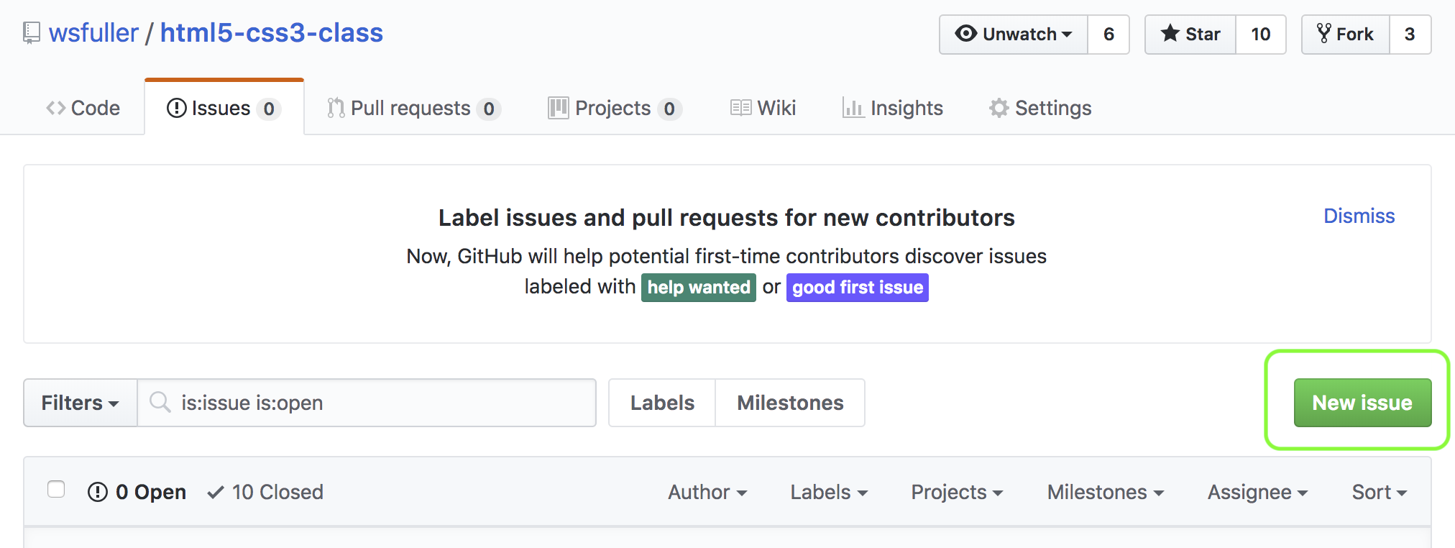
Intro: Help make things better
Just like anything in this industry, nothing is constant. I’m asking you to help me to ultimately help others make this a better class.
Make GitHub Issues

Slide 26
Wireframes

Slide 27
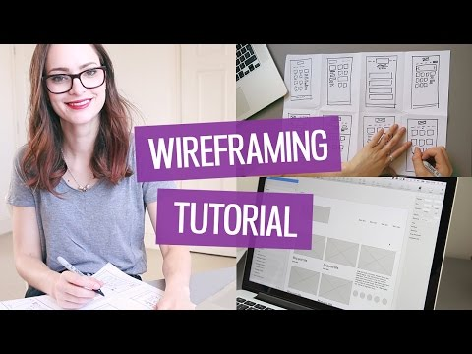
Wireframe: How to Wireframe
Video Link

Slide 28
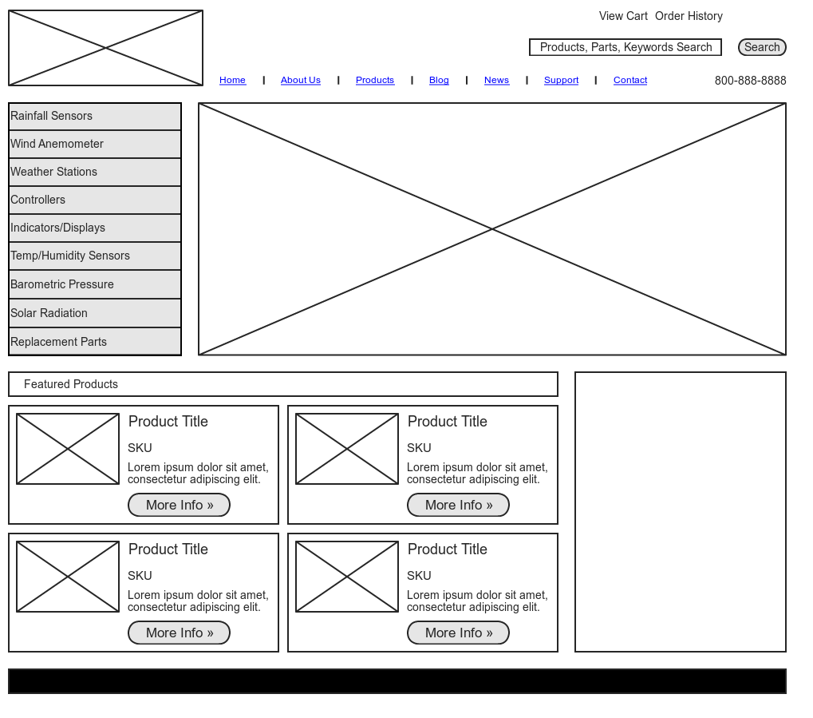
Intro: Wireframe Examples
Wireframes should be simple but comprehensive
Example 1
Example 2
Example 3

Slide 29
Wireframe: Tools/Setup
You can essentially wireframe using any medium
You can use
Pen and Paper
Illustrator
Sketch
Photoshop
Draw.io
Balsamiq
All submitted work needs to be
.png
.jpeg/jpg
Canvas Size (guide)
Width: 1400px
Height: 1000px but allow for this to expand

Slide 30

Homework
Identify band/artist
Read Ch. 3 & 6
Wireframe
Home
About
Discography

Slide 31
Index
jQuery
Git
GitHub
CSS Flexbox Guide
Bootstrap
HTML5/CSS3 Book
inVision
Demo Site
GitHub Desktop
Atom Text Editor
Wireframe Video

